Slide 1




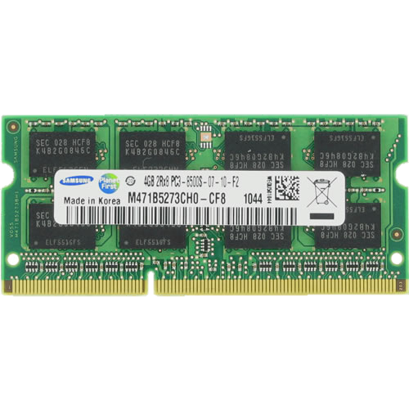
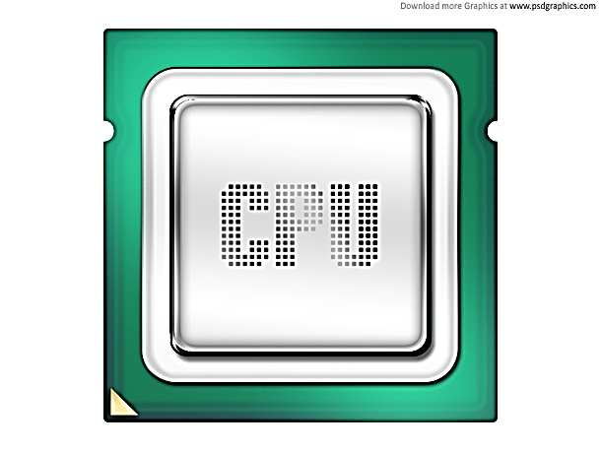
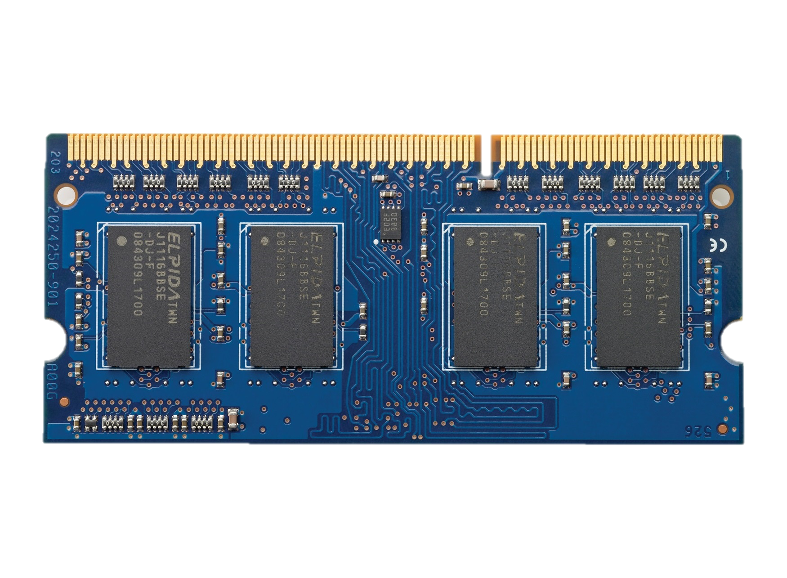

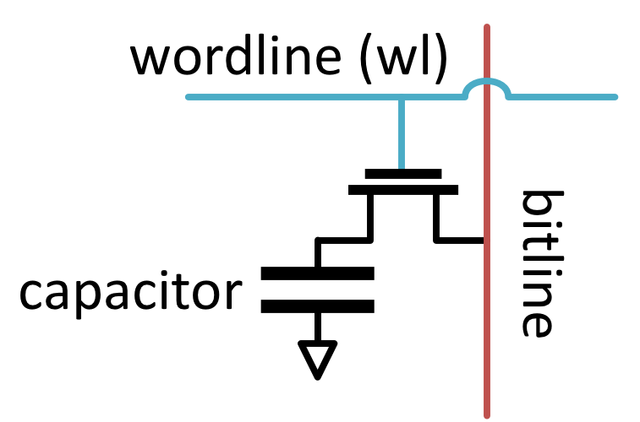


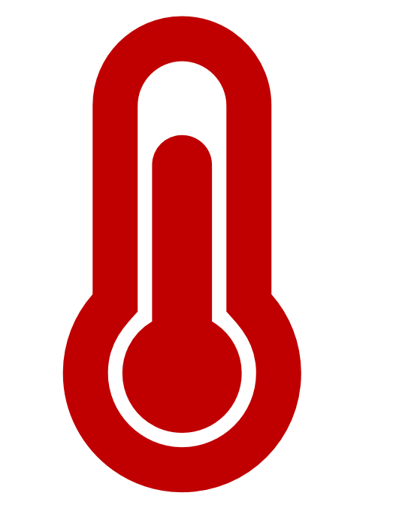

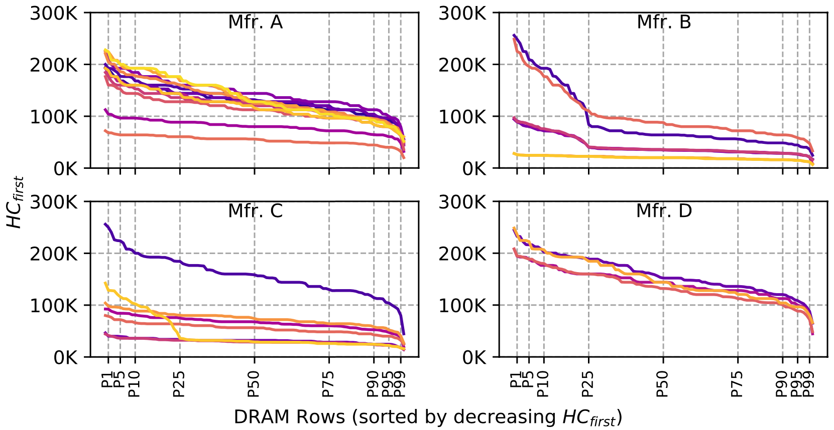
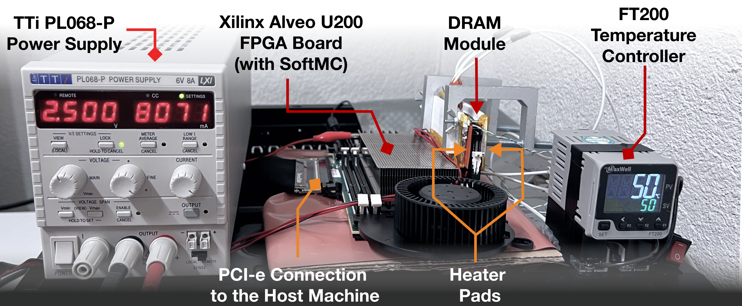
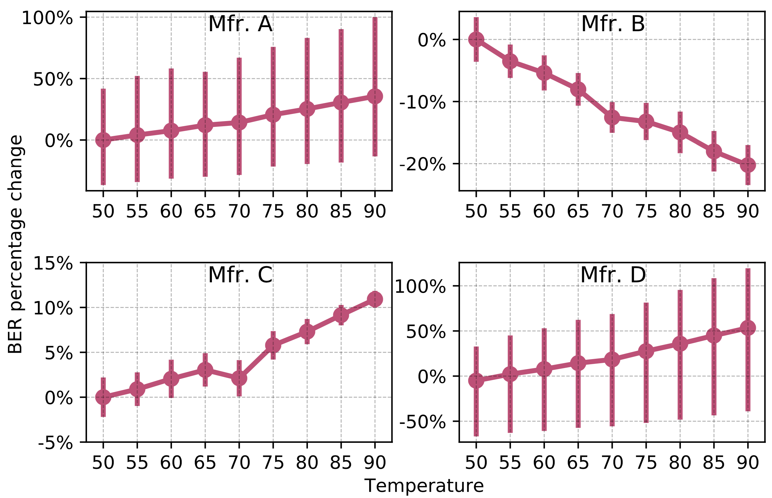
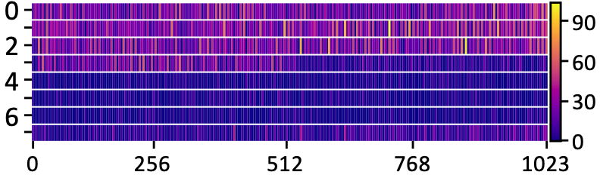



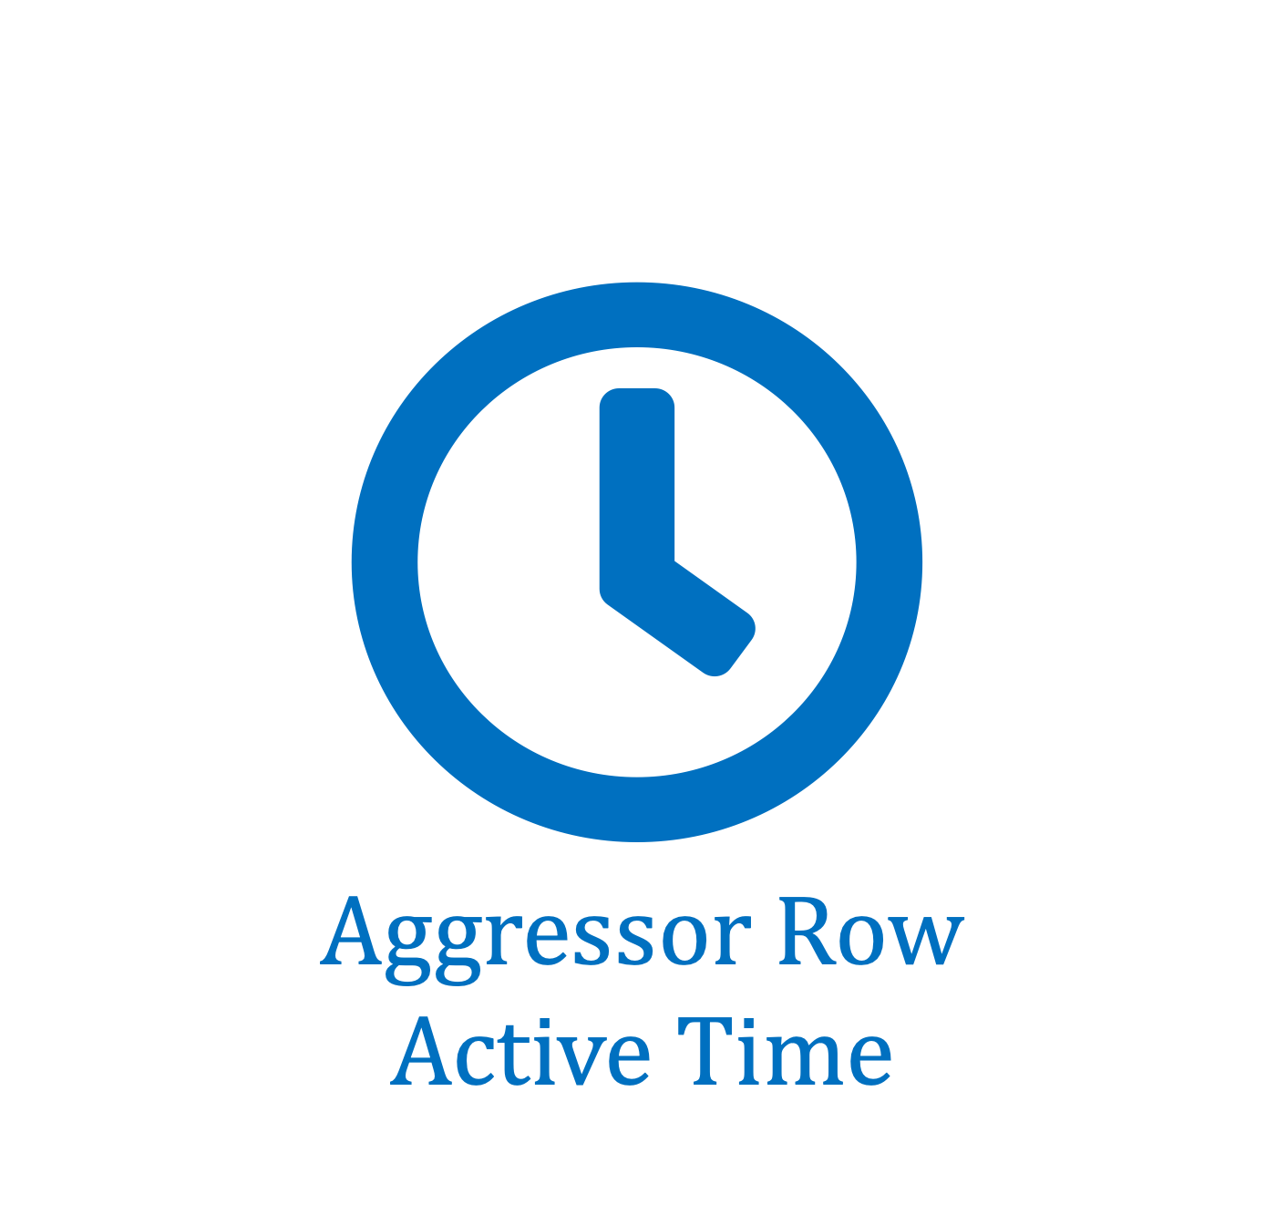

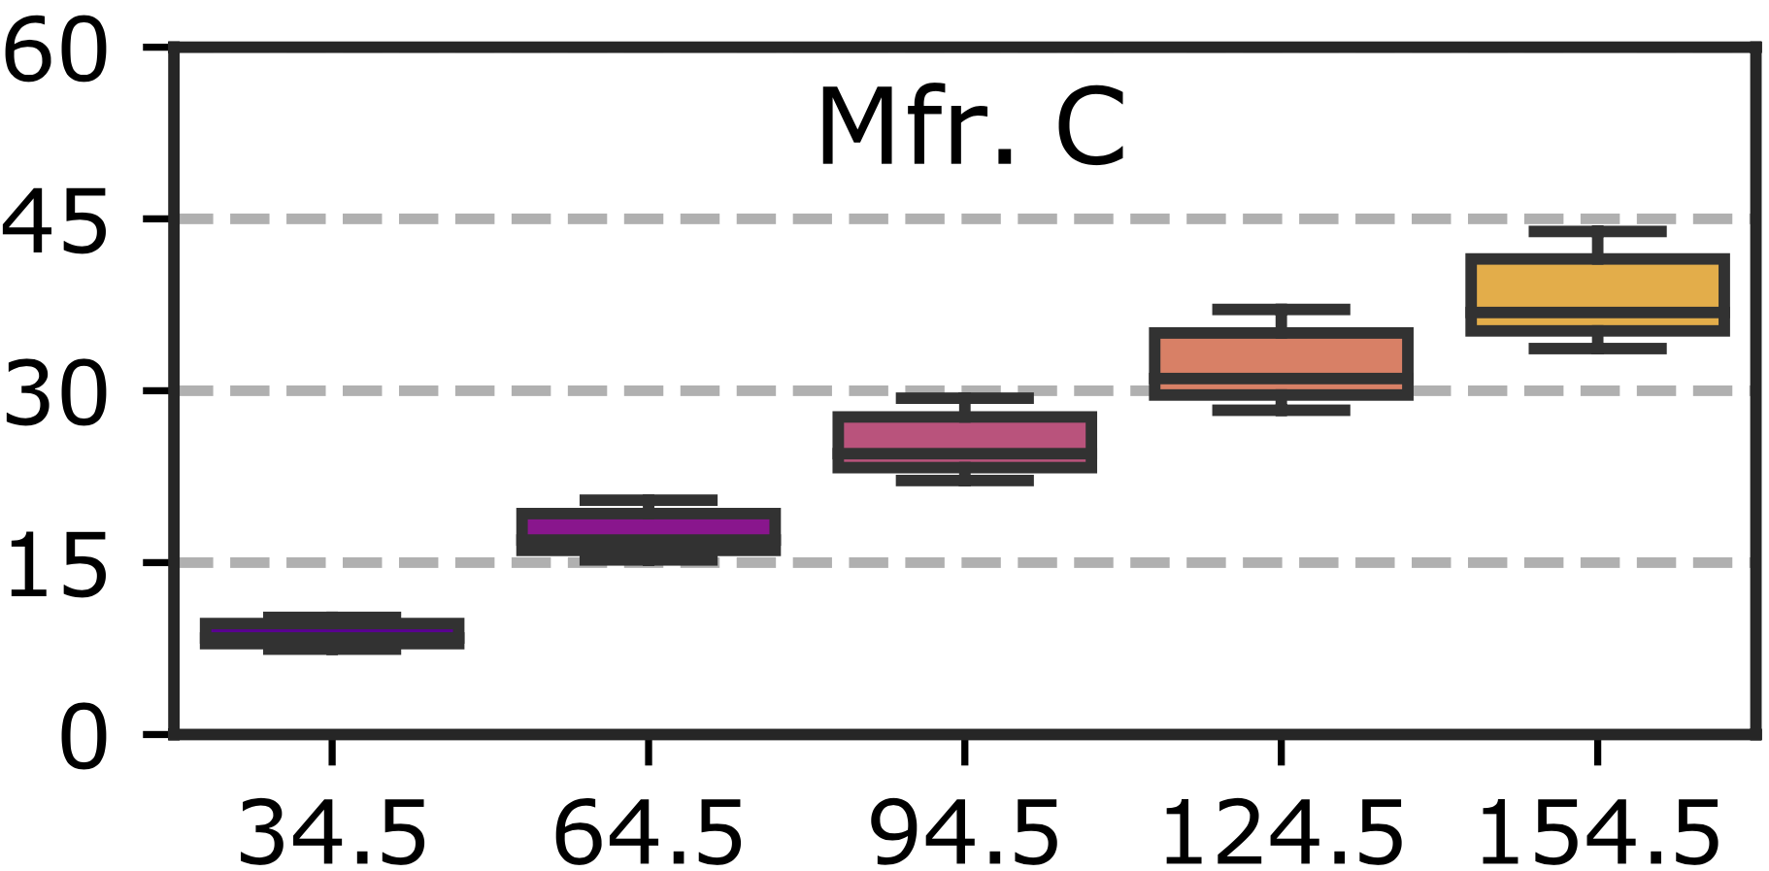
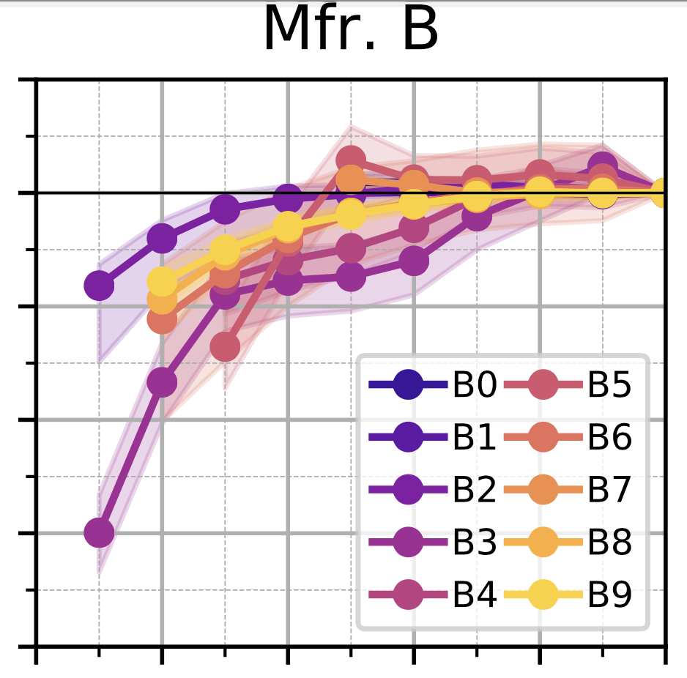
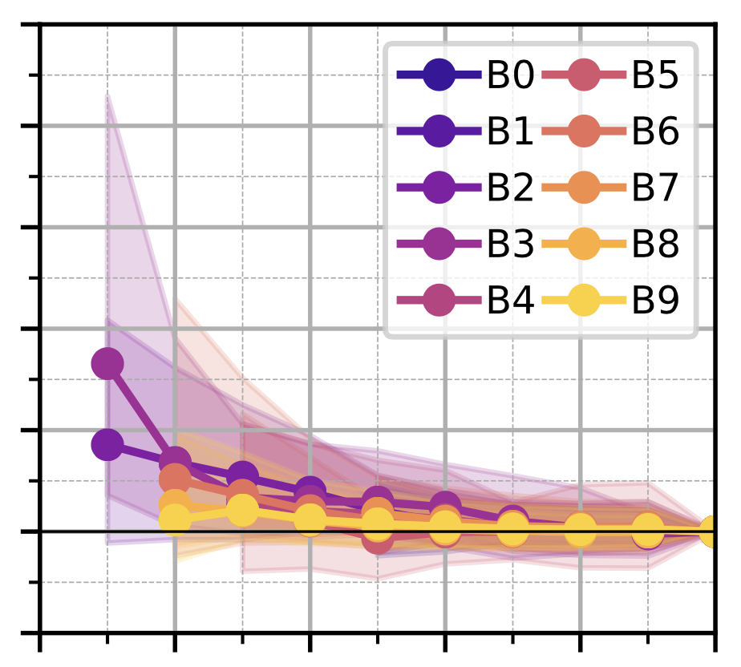




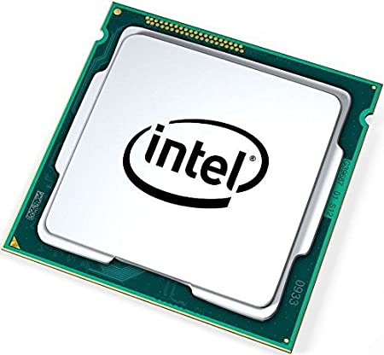

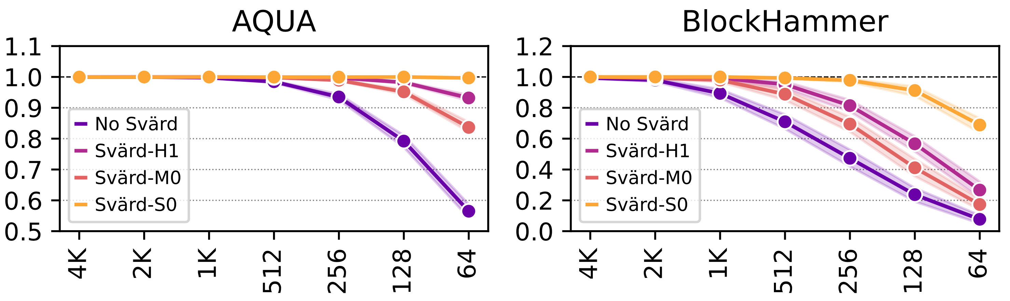



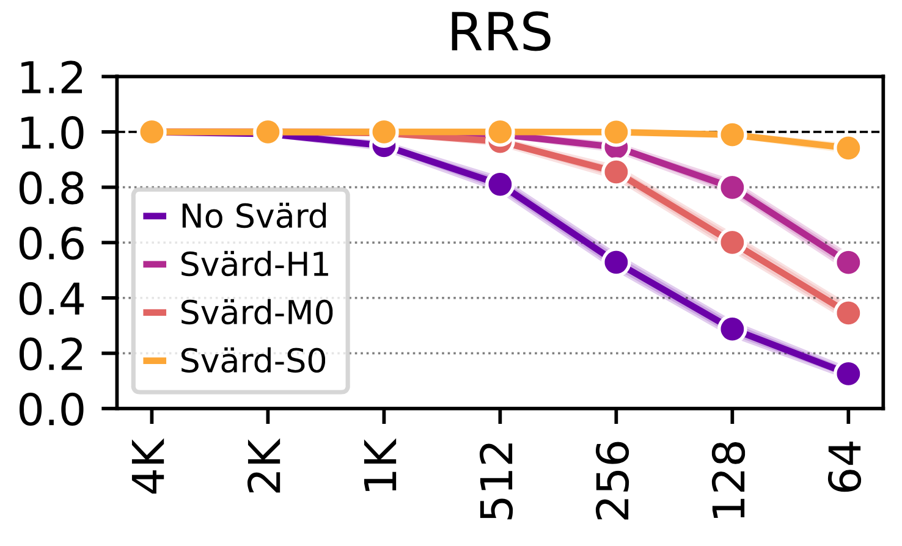
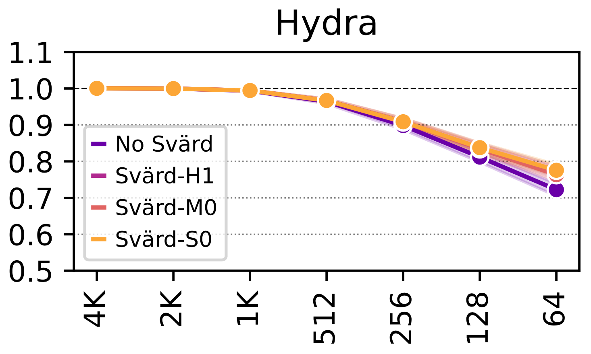

Enabling Efficient and Scalable DRAM Read Disturbance Mitigation via New Experimental Insights
Contact Info
Abdullah Giray Yaglikci
Onur Mutlu
Lightning Talk
1. DRAM Background
2. Problem and Motivation
1: DRAM Background
2: Goal
DRAM Organization
DRAM Read Disturbance
Address Virtualization
Application Level
DRAM Organization
DRAM Read Disturbance
More than 10X reduction
DRAM Subarray
RowHammer
[Kim+ ISCA’14]
Repeatedly opening and closing
OR keeping open
a DRAM row causes
bitflips in nearby cells
Virtual Memory Address
Preventive refresh is a blocking operation
Row 0
Row 0
2020
Victim Row
System Level
DRAM Subarray
Mfr. Year
REF
Row 1
ACT
Row 1
Row 1
Row 0
2014
bitline
DRAM Cell
Victim Row
Visible within the Processor
Physical Memory Address
Row 0
Bank
RowPress [Luo+ ISCA’23]
Victim Row
wordline
Row 2
DRAM
Channel
Row 2
Row 2
Row 2
open
Row 1
Minimum Activation Count to Observe a Bitflip
Chip I/O
…
closed
Aggressor Row
Row 1
Row 1
bitline
Victim Row
…
Row 3
DRAM Module
Row 3
DRAM Cell
Row 3
No memory access during a preventive refresh
Bank
wordline
Row 2
Modern DRAM chips are more vulnerable
Defenses are becoming prohibitively expensive
Victim Row
Memory Controller Level
Row 2
Row 2
Row 2
…
open
…
…
closed
Aggressor Row
…
…
Row 4
DRAM Bus Addresses
(Channel, Rank,…, Row, Col)
Row 4
Chip I/O
…
Row 3
Row Buffer
Victim Row
Row 3
Row 3
…
…
…
…
Victim Row
To gain insights into DRAM read disturbance and its fundamental properties
DRAM Chip
DRAM Bank
An attacker can trigger many preventive actions
to block access to main memory
Row 4
Row 4
…
Row Buffer
Victim Row
SA₀
SA₁
SA_{N-1}
[Kim+, ISCA’14]
DRAM Chip
DRAM Bank
Repeatedly opening and closing
OR keeping open
a DRAM row causes
bitflips in nearby cells
Sense Amplifiers (SAs)
[Kim+, ISCA’20]
DRAM Chip
DRAM Chip
SA₀
SA₁
…
SA_{N-1}
RowHammer
[Kim+ ISCA’14]
[Luo+, ISCA’23]
Physical Ranks, Banks, Rows and Columns
Sense Amplifiers (SAs)
RowPress [Luo+ ISCA’23]
To prevent RowHammer efficiently, scalably and with no proprietary information
Sense
Amplifier
Proprietary
Read disturbance mitigation is a potential attack vector
to reduce availability of the main memory
Sense
Amplifier
DRAM Cell
3. Thesis Statement
DRAM Cell
2. Problem Definition
3: Understanding the Vulnerability of Modern Memory Chips to Read Disturbance
DRAM read disturbance mitigation mechanisms
poorly scale with shrinking technology node
rely on proprietary information
We can mitigate DRAM read disturbance efficiently and scalably by
building a detailed understanding of DRAM read disturbance
leveraging insights into modern DRAM chips and memory controllers
devising novel solutions that do not require proprietary knowledge of DRAM chip internals
1
2
3
3: Building a Detailed Understanding of DRAM Read Disturbance
Methodology
DRAM Chip Temperature
no bitflips
bitflips
no bitflips
Physical
Location
Vulnerable Temperature Range
Temperature
Minimum Activation Count
to Observe a Bitflip (HC_{first})
A DRAM cell is vulnerable in a bounded temperature range and overall bit error rate changes with temperature based on the DRAM vendor
Chip ID
# of Bitflips in a Column
Full Paper
A Deeper Look into RowHammer’s Sensitivities
[Orosa, Yaglikci+ MICRO’21]
Variation in Bit Error Rate per DRAM Row
Column Index
DRAM Rows (sorted)
Fine-grained control over
DRAM commands e.g., ACT, PRE, RD, WR, and REF
Timing parameters (±1.5ns),
Temperature (±0.5°C ),
Wordline Voltage (±1mV)
We test 250+ DRAM Chips
Full Paper
A Deeper Look into RowHammer’s Sensitivities
[Orosa, Yaglikci+ MICRO’21]
Both manufacturing process and design decisions affect vulnerability to read disturbance
Full Paper
DRAM Bender
[Olgun+ TCAD’23]
GitHub
Repository
Temperature (°C)
Wordline Voltage
Memory Access Patterns
As the aggressor row
stays active longer, more DRAM cells experience bitflips and bitflips occur at lower activation counts
1.2
1.0
0.8
0.6
0.4
0.2
2.0
1.8
1.6
1.4
1.2
1.0
0.8
Bit Error Rate
(Normalized to VPP=2.5V)
Minimum Activation Count to Induce the First Bitflip (Normalized to VPP=2.5V)
Number of Bitflips
per DRAM Row
Lower is better
Higher is better
Variation across DRAM rows
Full Paper
RowHammer under Reduced Wordline Voltage
[Yaglikci+ DSN’22]
1.5 1.7 1.9 2.1 2.3 2.5
1.5 1.7 1.9 2.1 2.3 2.5
Aggressor Row Active Time (ns)
Wordline Voltage: VPP (V)
Wordline Voltage: VPP (V)
5: Conclusion and Future Work
Paved the way to the discovery of RowPress [Luo+ ISCA’23]
Fewer DRAM cells experience bitflips and bitflips occur at higher activation counts under reduced wordline voltage
Goal: Understand and solve DRAM read disturbance
Contributions:
Read disturbance in modern DRAM chips with varying
Effective and scalable mitigation by
selectively throttling memory accesses
reducing the performance overhead of refreshes
Future Works:
Holistically Understanding DRAM Read Disturbance
aging of DRAM chips
environmental conditions
memory access and data patterns
effects of system design decisions
More Efficient and Flexible Mitigations
in-field patchable / reconfigurable / programmable
cross-layer communication
revisiting the isolation of responsibilities
4: Leveraging Insights into Modern DRAM Chips and Memory Controllers
5: No Proprietary Knowledge
Svärd: Spatial Variation-Aware Read Disturbance Defenses
HiRA: Hidden Row Activation
BlockHammer: Selectively Throttling Accesses
temperature
access pattern
physical location
wordline voltage
Dynamically adapts the aggressiveness of a defense to the victim row’s vulnerability level
Subarray_{N}
Full Paper
HiRA: Hidden Row Activation
[Yaglikci+ MICRO’22]
Decoder
···
A RowHammer attack hammers Row A
BlockHammer detects a RowHammer attack using area-efficient Bloom filters
BlockHammer selectively throttles accesses from within the memory controller
Bitflips do not occur
BlockHammer can inform the system software about the attack
Subarray₁
Bank
Global I/O
Row A
Refreshing two rows in two different subarrays:
Using nominal timing parameters:
Using HiRA:
HiRA works in 56 off-the-shelf DRAM chips from SK Hynix
Physical
Row Layout
PARA
ACT RowA
t_{RAS}: 32ns
PRE
t_{RP}: 14ns
ACT RowB
t_{RAS}: 32ns
PRE
time
Weighted Speedup
(Norm. to No Mitigation Baseline)
t₁: 3ns
t₂: 3ns
t_{RAS}: 32ns
51.4% reduction
Full Paper
BlockHammer
[Yaglikci+ HPCA’21]
GitHub
Simulator Source Code
ACT
RowA
PRE
ACT
RowB
PRE
time
Scalability with Worsening DRAM Read Disturbance:
Competitive with state-of-the-art mechanisms (<0.6% overhead) when there is no attack
Superior performance (71% speedup) and DRAM energy (32% reduction) when a RowHammer attack is present
Compatibility with Commodity DRAM Chips:
BlockHammer requires
no proprietary information of in-DRAM row mapping
no changes to DRAM chips
Minimum Hammer Count to Induce the First Bitflip (HC_{first})
12.6% speedup by hiding periodic refresh latency
3.7x speedup
by hiding preventive refresh latency
Svärd significantly increases system performance
by 1.63x, 4.88x, 1.07x, 1.95x, and 4.80x, over AQUA, BlockHammer, Hydra, PARA, and RRS, respectively,
for HC_{first} of 64
Full Paper
Spatial Variation-Aware RowHammer Defenses
[Yaglikci+ HPCA’24]
More info: agyaglikci@gmail.com & https://agyaglikci.github.io

